Slide 1
Regression Analysis
Simple Linear Regression
Nicoleta Serban, Ph.D.
Professor
School of Industrial and Systems Engineering
Regression Concepts:
Assumptions and Diagnostics

Slide 2

About This Lesson

Slide 3
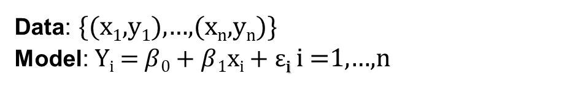
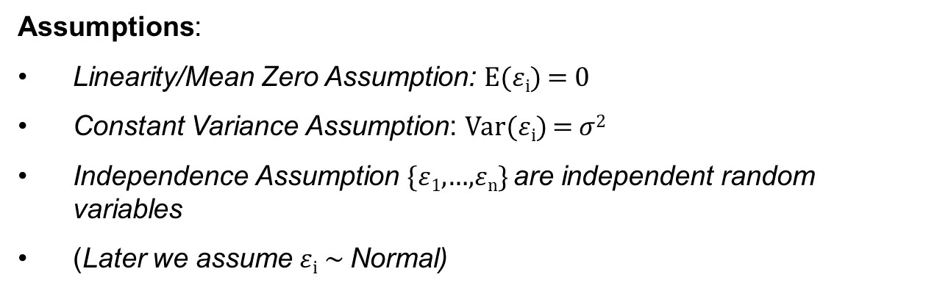
Simple Linear Regression: Model
Data: {(x₁,y₁),…,(x_{n},y_{n})}
Model: Y_{i} = $β$₀ + $β$₁x_{i} + $\text{ε}$_{i} i =1,…,n
Assumptions:
Linearity/Mean Zero Assumption: E($ε$_{i}) = 0
Constant Variance Assumption: Var($ε$_{i}) = $σ$²
Independence Assumption {$ε$₁,…,$ε$_{n}} are independent random variables
(Later we assume $ε$_{i} ~ Normal)

Slide 4

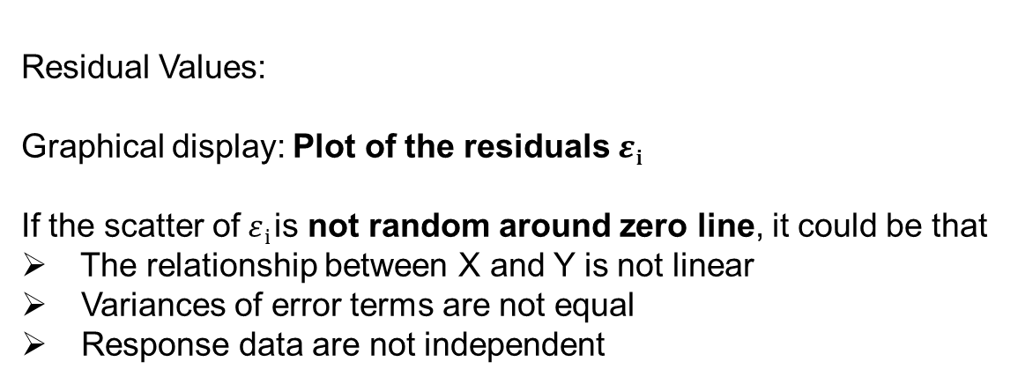
Residual Analysis
Residual Values:
Graphical display: Plot of the residuals$ε$_{i}
If the scatter of$ε$_{i} is not random around zero line, it could be that
The relationship between X and Y is not linear
Variances of error terms are not equal
Response data are not independent
$$ε\text{i} \text{→} {\hat{ε}}_{i}=y_{i}−({\hat{β}}_{0}+{\hat{β}}_{1}x_{i})$$

Slide 5
Checking Assumptions: Residual Analysis
Linearity Assumption:
This shows that there may be a non-linear relationship between X and Y.

Slide 6

Checking Assumptions: Residual Analysis
Constant Variance Assumption:
The residuals show larger variance as the fitted values increase.
$$\hat{y}$$
Here, it could be that $σ$² is not constant.

Slide 7
Checking Assumptions: Residual Analysis
Independence Assumption:
There are clusters of residuals: the independence assumption does not hold.
Using residual analysis, we check for uncorrelated errors but not independence.
Independence is a more complicated matter. If the data are from a randomized trial, then independence is established, but most data are from observational studies.

Slide 8
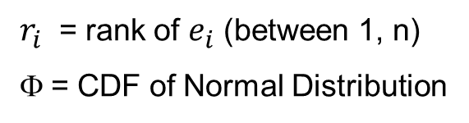

Checking the Assumption of Normality
One way to check this assumption in a regression is using a Normal Probability Plot
Let the R statistical software do this for you!
A straight line in normal probability plot implies assumption of normality is valid
Curvature (especially at the ends) shows non-normality
x-axis:
y-axis: $e_{i}$
$r_{i}$ = rank of $e_{i}$ (between 1, n)
Φ = CDF of Normal Distribution

Slide 9
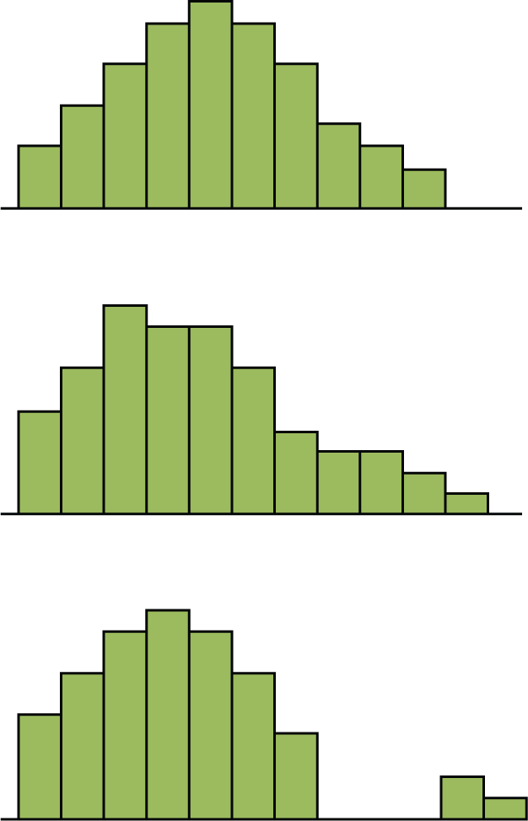
Checking the Assumption of Normality
A complementary approach to check for the normality assumption is by plotting the histogram of the residuals
Normality Assumption:
The residuals should have an approximately symmetric distribution, unimodal, and with no gaps in the data.

Slide 10
Variable Transformation
If the model fit is inadequate, it does not mean that a regression is not useful.
One problem might be that the relationship between X and Y is not exactly linear.
To model the nonlinear relationship, we can transform X by some nonlinear function such as:

Slide 11
Normality Transformations
Problem: Normality or constant variance assumption does not hold.
Solution: Transform the response variable from y to y* via
y* = y^{λ}
where the value of λ depends on how Var(Y) changes as X changes.
(don’t transform)
This is called Box-Cox Transformation: The parameter λ can be determined using R statistical software.
y* = ln(y)

Slide 12

Summary

